Slide 1
Sentiment Analysis An Intelligent User Interface
Guidance: by- Prof. Dr. valentin Schwind Gaurav Kapadiya kshitij yelpale pranay raman Safir mohammad shaikh Shubham girdhar

Slide 2
Introduction
Sentiment Analysis is -
the term which is used very often in web-based business sites, social networks and different fields.
an examination field to analyze people’s subjective sentiments.
More Advanced, Focus on “Beyond Polarity”

Slide 3
Motivation
Why this topic?
Why LSTM and Bayes?
Our Aim!

Slide 4
Related Work - Research
An attempt to gather -
Reviews
Feedback
Remarks
Expressions
Emotions

Slide 5
Related Work - Findings
Research on
Multi Task Classification
Word2Vec – A tool for computing word vectors.
LSTM prompts better exploratory outcomes [1]
Word Embeddings
Dictionary mapping all the words to vectors [2]
Semantic Composition
Combine singular word embeddings into a representation of an expression [3]
Summary

Slide 6
Research Question
Is LSTM based model better than Bayes for sentiment analysis ?
Null Hypothesis (H0): There is no difference between the performance of LSTM and Bayes based models
Alternate Hypothesis (H1): LSTM outperforms Bayes for sentiment classification for longer text reviews.

Slide 7
Study Design
Dependent variables (DV): 1 (Accuracy)
Kind of DV: Continuous (Ratio)
Independent Variable (IV): 1 (Type of model)
Kind of IV: Discrete (1,2)
Levels of discrete IV: 2 (LSTM, Bayes)
Within subject IV: YES

Slide 8
Our Experiment
Platform: Interactive web application
Survey procedure: Participants were asked to rate multiple long movie reviews through the user-interface of the web application. The users used the slider bars present under each review on the user interface to give the ratings on a scale of 0 to 1 (0 - negative, 1 - positive)

Slide 9
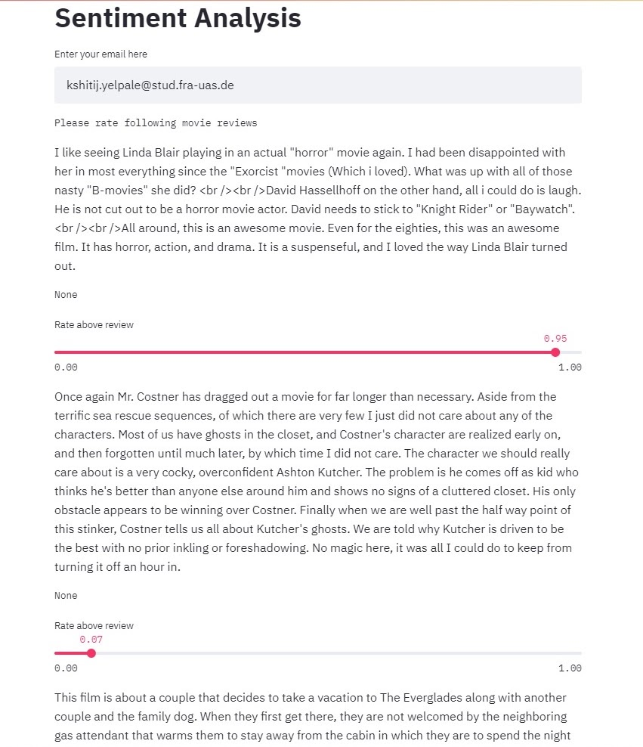
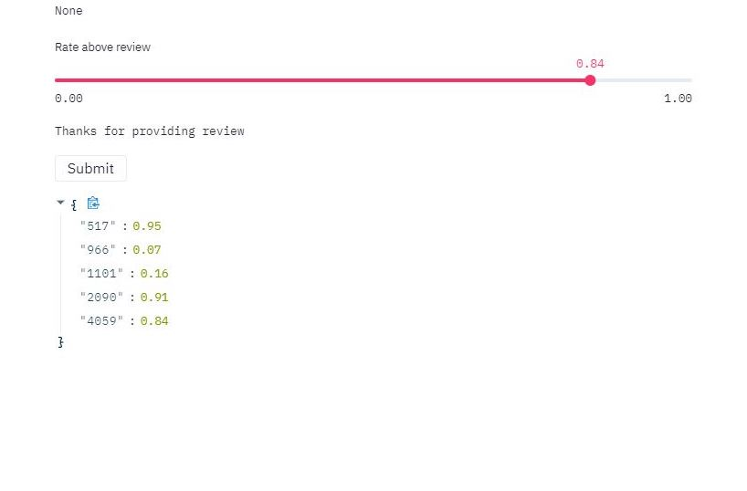
Application Design

Slide 10
Database Design
Reviews
User_Ratings
ID | Review | LSTM_PREDICTION | BAYES_PREDICTION | ACTUAL_SENTIMENT
5 | R5 | 0.65 | 0.85 | 0.80
8 | R8 | 0.15 | 0.20 | 0.30
ID | LSTM_DEVIATION | BAYES_DEVIATION | USER_SENTIMENT | Review_Id
1 | 0.05 | 0.15 | 0.70 | 5
2 | 0.20 | 0.15 | 0.35 | 8

Slide 11
Implementation
Frontend: Python Streamlit
APIs: Python flask sqlalchemy
Backend: SQLITE database
Statistical Testing: Python Scipy, Matplotlib

Slide 12
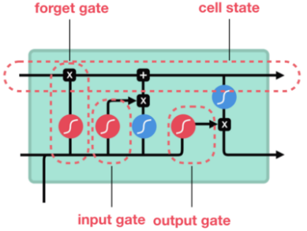
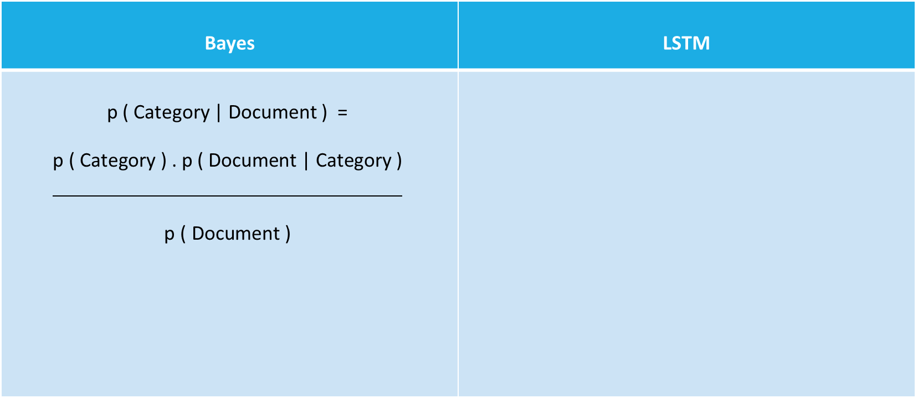
Models
Bayes | LSTM
p ( Category | Document ) = $$\frac{\begin{aligned}\text{p} \text{(} \text{Category} \text{)} \text{.} \text{p} \text{(} \text{Document} \text{|} \text{Category} \text{)} \\ \end{aligned}}{\begin{aligned} \\ \text{p} \text{(} \text{Document} \text{)}\end{aligned}}$$
Notes:
Medium. 2020. Introduction To The Architecture Of Recurrent Neural Networks (Rnns). [online] Available at: <https://medium.com/towards-artificial-intelligence/introduction-to-the-architecture-of-recurrent-neural-networks-rnns-a277007984b7> [Accessed 3 September 2020].

Slide 13
Bayes vs LSTM
Bayes
Library: Scikit-learn
Word Embedding: TF - IDF
Model: sklearn.naive_bayes.MultinomialNB( )
LSTM
Library: Keras
Word Embedding: One-Hot representation + Keras encoded Imdb format
Model: (Embedding + Bidirectional(LSTM( )) + Bidirectional(LSTM( )) + Dense)

Slide 14
Performance Measures
 | # Epochs | Training Accuracy | Validation Accuracy
LSTM (Trained on Custom IMDB Dataset with One-Hot Encoding) | 15 | 99.85 % | 81.29 %
LSTM (Trained on Keras’ IMDB Dataset) | 3 | 85.42 % | 82.81 %
Bi-LSTM (Trained on Keras’ IMDB Dataset) | 2 | 89.98 % | 86.89 %

Slide 15
Problems / Challenges
Context
Irony
Sarcasm
Emojis (:D, ¯ \ _ (ツ) _ / ¯ etc.)
Definition of Neutral
Overfitting
Large difference between training and validation accuracy
Keras’ feature updates!

Slide 16
Results - Correlation
Performed correlation test –
between predicted values of both models and actual sentiments
on 4500 documents (sentiments)
Correlation Coefficient Test | LSTM and Actual sentiment | Bayes and Actual sentiment
Pearson | 0.882 | 0.001
Spearman Rank | 0.886 | 0.002

Slide 17
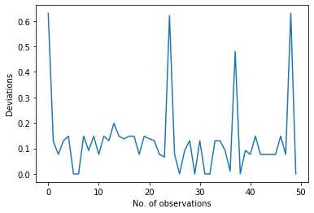
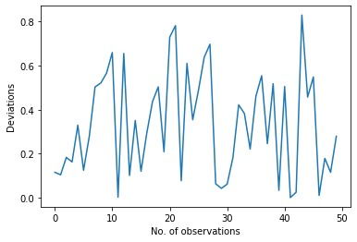
Results – Characteristic Values
Deviations | LSTM and User sentiment | Bayes and User sentiment
Mean | 0.133 | 0.335
Standard Deviation | 0.147 | 0.236
LSTM
Bayes

Slide 18
Results – T Test
P-value for 5% significance is 1.432e-06
So, H₀ is clearly rejected.

Slide 19
Future Work
Large dataset can be used
Evaluation of application can be done by more participants
More models can be taken into consideration
Different type of data can be used to as independent variables for models
These models can be integrated in actual applications like Recommender systems

Slide 20
Thank you!

Slide 21
References
[1] K. Cho, B. V. Merrienboer, C. Bahdanau, F. Bougares, H. Schwenk, and Y. Bengio. 2014. Learning phrase representations using RNN encoder– decoder for statistical machine translation. Technical Report. In Proc. EMNLP, Doha, Qatar, 2014, pp. 1724–1734
[2] T. Mikolov, K. Chen, G. Corrado, and J. Dean. 2013. Efficient estimation of word representations in vector space. Technical Report. https://arxiv.org/abs/1301.3781
[3] Ms.R.Monika, Dr.S.Deivalakshmi, and Dr.B.Janet. 2019. Sentiment Analysis of US Airlines Tweets using LSTM/RNN. Technical Report. Corrosion and Materials Protection Division CSIR-Central Electrochemical Research Institute Karaikudi, National Institute of Technology Trichy, India

